Slide 1
How has trending changed on YouTube between 2020 and 2022?

Slide 2




1
Introduction
2
Questions
3
Data Cleaning
Table of Contents
4
Likes and Comments
5
Title Variation
6
Publishing Day and Time
7
Conlusions

Slide 3

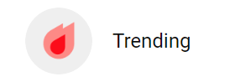


INTRODUCTION
According to YouTube, trending helps viewers to see "what's happening on YouTube and in the world." Another purpose of the trending tab is to "surface videos and shorts that a wide range of viewers would find interesting.
Trending is not personalised and is the same for all viewers in the same country.
The list is updated every 15 minutes.
Trending videos are flagged on videos like the example here:
https://support.google.com/youtube/answer/7239739?hl=en

Slide 4
INTRODUCTION
According to YouTube, Trending aims to surface videos that:
Are appealing to a wide range of viewers
Are not misleading, clickbaity or sensational
Capture the breadth of what's happening on YouTube and in the world
Showcase a diversity of creators
Ideally, are surprising or novel
Trending considers many signals, including (but not limited to):
View count
How quickly the video is generating views (i.e. “temperature”)
Where views are coming from, including outside of YouTube
The age of the video
How the video performs compared to other recent uploads from the same channel
https://support.google.com/youtube/answer/7239739?hl=en
https://blog.hootsuite.com/how-the-youtube-algorithm-works
Notes:
All these factors mean that "the video with the highest view count on a given day may not be #1 on Trending, and videos with more views may be shown below videos with fewer views."
Since 2016 YoTube has been focused on brand safety which has affected the trending algorithm whereas the homepage is more affected by personalization and but so do factors such as
click-through rate
average view duration
average percentage viewed
likes
dislikes
viewer surveys.

Slide 5
INTRODUCTION
For this project, I have chosen to analyse the YouTube videos that were ranked as trending in the months of September 2020 and September 2022 in the UK to compare the difference in trending factors between the two years.
Factors like this are important for creators to know so that they can adapt their content to the changing algorithms. Especially as YouTube does not allow them to know the full picture of the algorithms and it is down to the creator to figure them out.

Slide 6
QUESTIONS
How have the views, likes and comments changed between September 2020 and September 2022 for trending videos?
What are the different variations in video titles of trending videos?
What are the differences in channels with the most trending videos between September 2020 and September 2022?
Is there a difference in publishing day of trending videos between September 2020 and September 2022?

Slide 7
Data Exploration and Cleaning
The data was acquired from https://www.kaggle.com/datasets/datasnaek/youtube-new
The CSV file that was downloaded was GBvideos.csv
Then the data was filtered by month and year and two new CSV files were created, one for September 2020 and one for September 2022. Duplicate videos were also dropped
These two dataframes were then merged to create a third

Slide 8
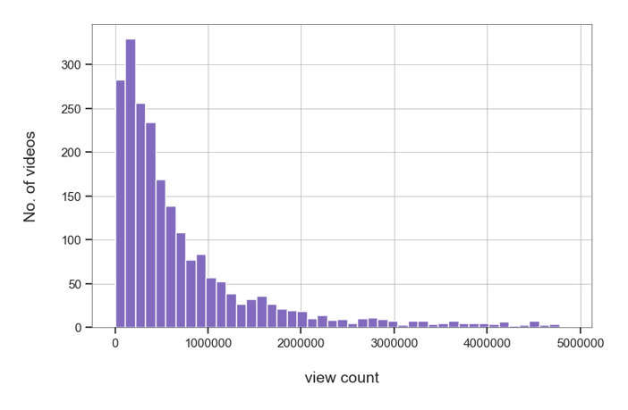
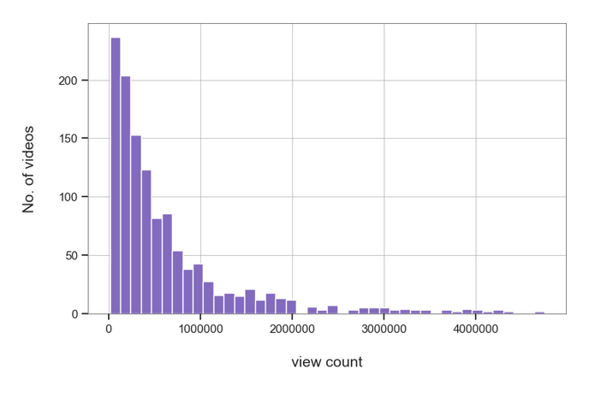
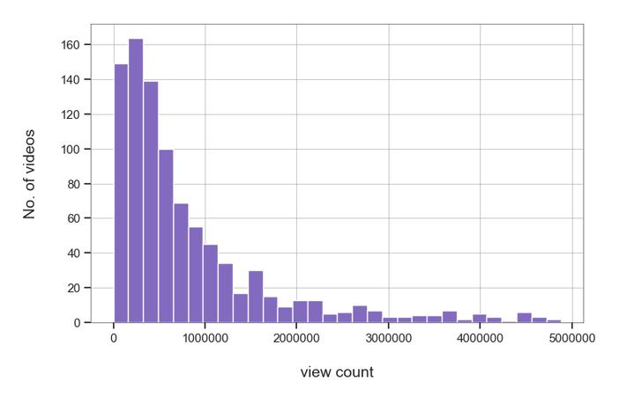
Views
Compared to 2020, in 2022 videos were more likely to have a higher view count.
This could imply that either the trending algorithm relies more on videos that have higher views, more people are viewing the trending tab or more people are watching YouTube in general .
Overall
2020
2022

Slide 9
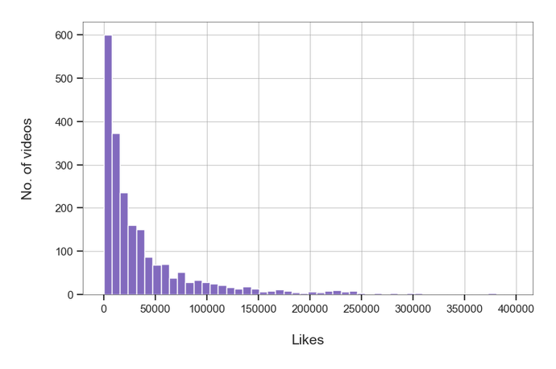
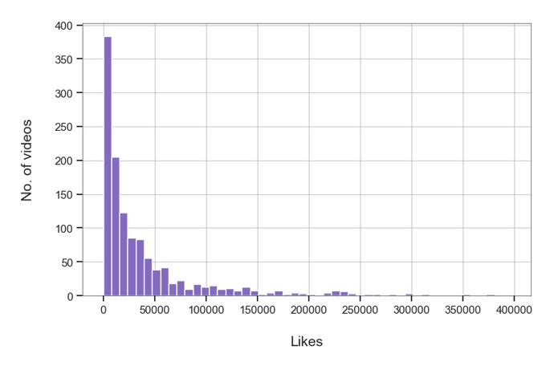
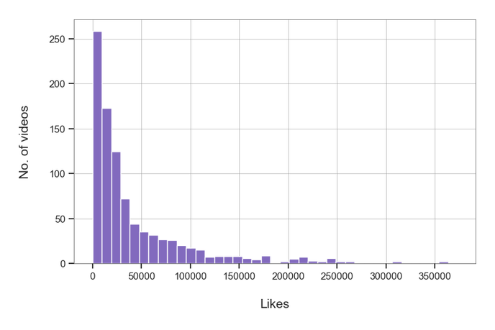
Likes
Unlike views, the number have likes on trending videos in 2022 is similar to that in 2022
This implies that the number of likes on a YouTube video has not changed importance in the trending algorithm since 2020.
Overall
2020
2022

Slide 10
Comment Count
Overall, 73% of videos had over 4000 comments
In 2020 70% of videos had over 4000 comments
In 2022 76% of videos had over 4000 comments
This indicates that comments may be more important to the trending algorithm in 2022 than in 2020 or that videos that encourage users to engage further with their content are pushed

Slide 11
How have the views, likes and comments changed between September 2020 and September 2022 for trending videos?
Overall, video views on trending videos have increased and so have comments but likes have stayed at a similar rate.
This implies that views and comments have gone up in importance in relation to the algorithm whereas likes have stayed the same.

Slide 12
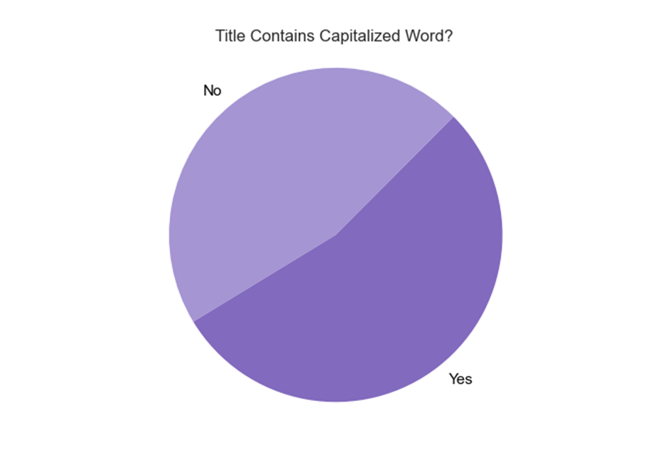
Title Variations -
Capital Letters
Over 50% of videos that trend on YouTube contains word capitalization. This could mean that the whole title is capitalized.
Having capitals in your title could be more eye-catching to viewers leading to more engagement and therefore could aid in the process of becoming a trending video

Slide 13

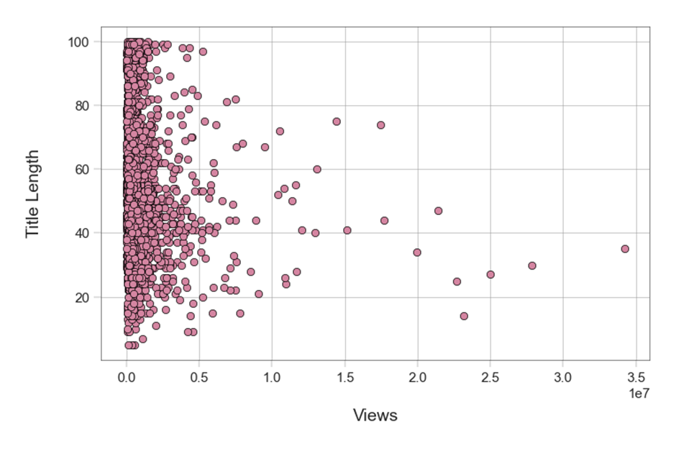
Title Variations -
Title Length
This chart shows that although there is a lot of variation in views compared to title length, videos with more views appear to have a medium length title.

Slide 14
What are the different variations in video titles of trending videos?
Key words, capital letters and title length are three was that titles can vary. These variations can attract different types of views to their videos.
There is variation in titles of trending videos on YouTube however, although they appear to be a factor in the algorithm there is no clear evidence as to how.

Slide 15
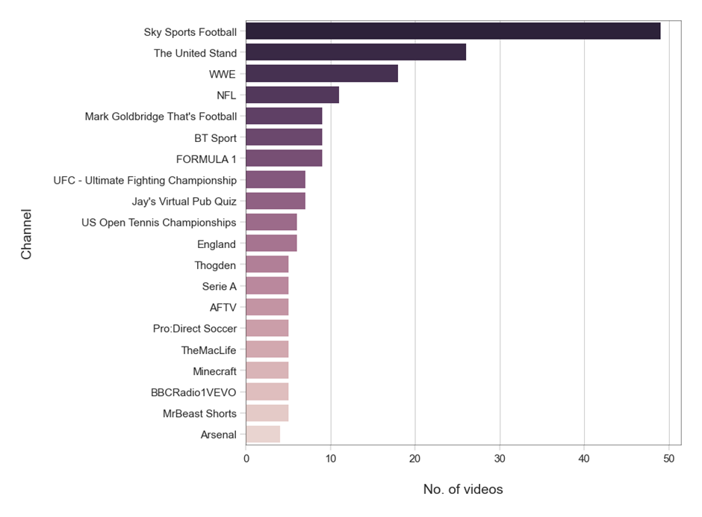
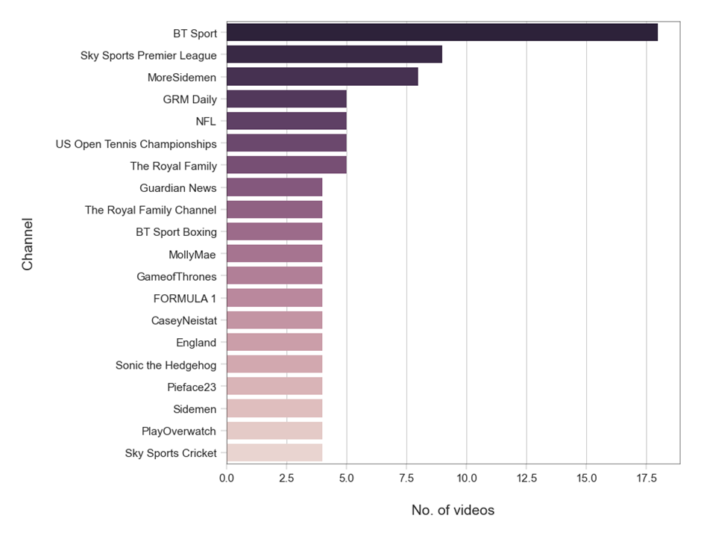
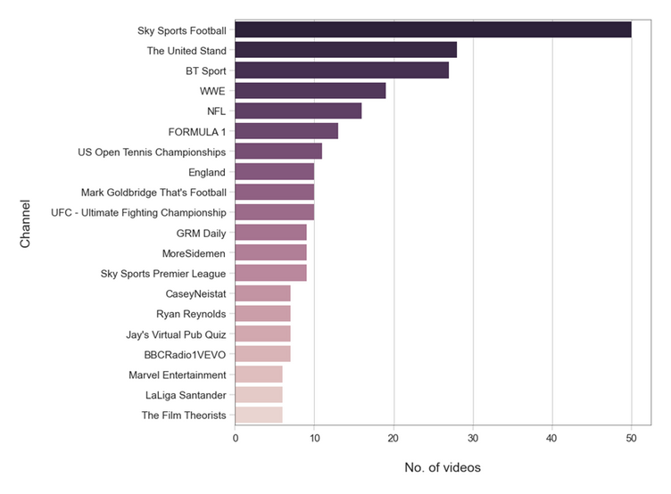
The Channels with the Most Trending Videos
2020
2022
Overall

Slide 16
The Channels with the Most Trending Videos
2020
2022

Slide 17



The Channels with the Most Trending Videos
2022
2020

Slide 18
What are the differences in channels with the most trending videos between September 2020 and September 2022?
Trending channels in the UK are heavily centered around sports and current events. These are the only channels that are on both trending lists.
Although maybe common sense, the channels that trend in 2022 are relevant to the current events in that time e.g., the royal family.

Slide 19
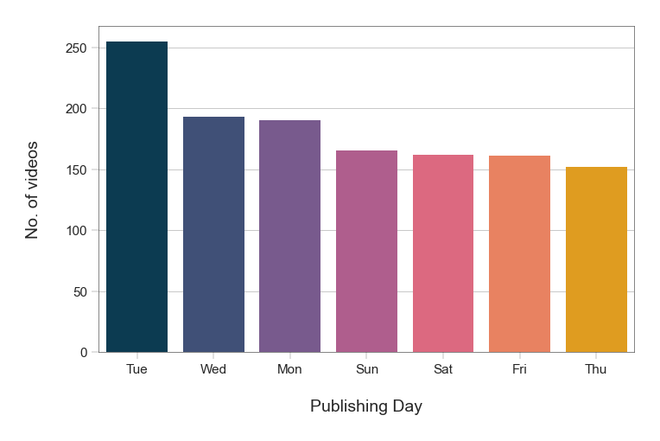
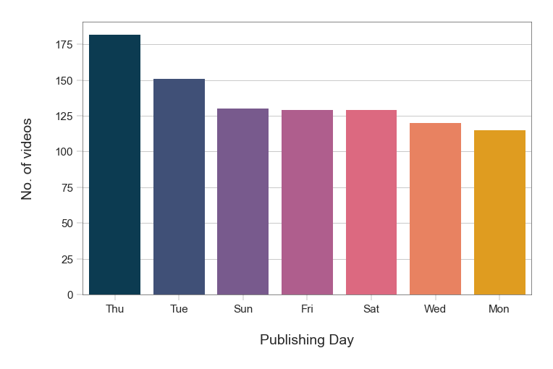
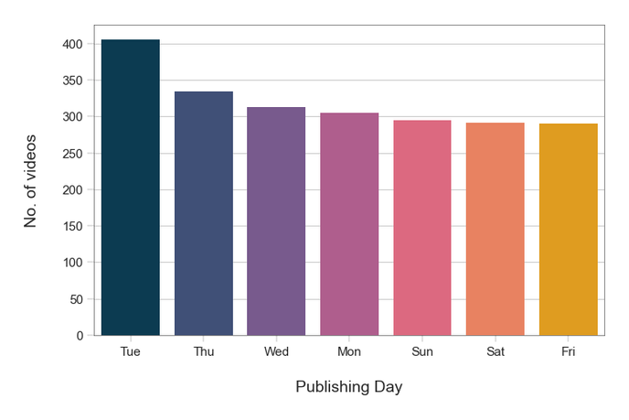
Publishing Day
2020
2022
Overall

Slide 20
Publishing Day
Compared to 2020 in 2022 Thursday was the most common publishing day that led to a trending video, whereas in 2020 this was the least common
2020
2022

Slide 21
Is there a difference in publishing day of trending videos between September 2020 and September 2022?
2020
Compared to 2020 in 2022 Thursday was the most common publishing day that led to a trending video, whereas in 2020 this was the least common
Tuesday, which was the most popular posting day in 2020 is still an important day in 2022 as it only fell one place
2022
This does imply that the day a video is published does affect the algorithm however, it does change overtime and therefore creators shouldn’t get comfortable.

Slide 22
CONCLUSIONS
Views and comments have gone up in importance in relation to the algorithm whereas likes have stayed the same.
There is variation in titles of trending videos on YouTube however, although they appear to be a factor in the algorithm there is no clear evidence as to how.
Th only channels that trended in the top 10 in both 2020 and 2022 were sports channels. Implying that creators can find it hard to stay consistently trending as trending channels in the UK are heavily centered around sports and current events
The day a video is published is important in the algorithm however, it does change overtime and therefore creators shouldn’t get comfortable.

Slide 23
ANY QUESTIONS?

Slide 24
Refrences
https://support.google.com/youtube/answer/7239739?hl=en
https://www.kaggle.com/datasets/datasnaek/youtube-new
https://blog.hootsuite.com/how-the-youtube-algorithm-works
Thank You!

